Slide 1

Notes:
Image retrieved from: https://www.thedailybeast.com/epa-on-un-climate-change-report-what-report-havent-heard-of-it
Slide note:
Hello everybody. Climate change has been at the top of our minds and at the forefront of political discussions today. Scientists are tasked to understand the ever changing atmosphere and they need help to better understand the clouds. Which will help them to demystify climate change.

Slide 2

Understanding Cloud Organization from Satellite Images
DL 3546 – University Of Toronto – December 2019

Slide 3



THE TEAM
Rueen Fiez
Naresh Patel
Nisarg Patel

Slide 4
AGENDA
Problem
Key Findings
Solution

Slide 5
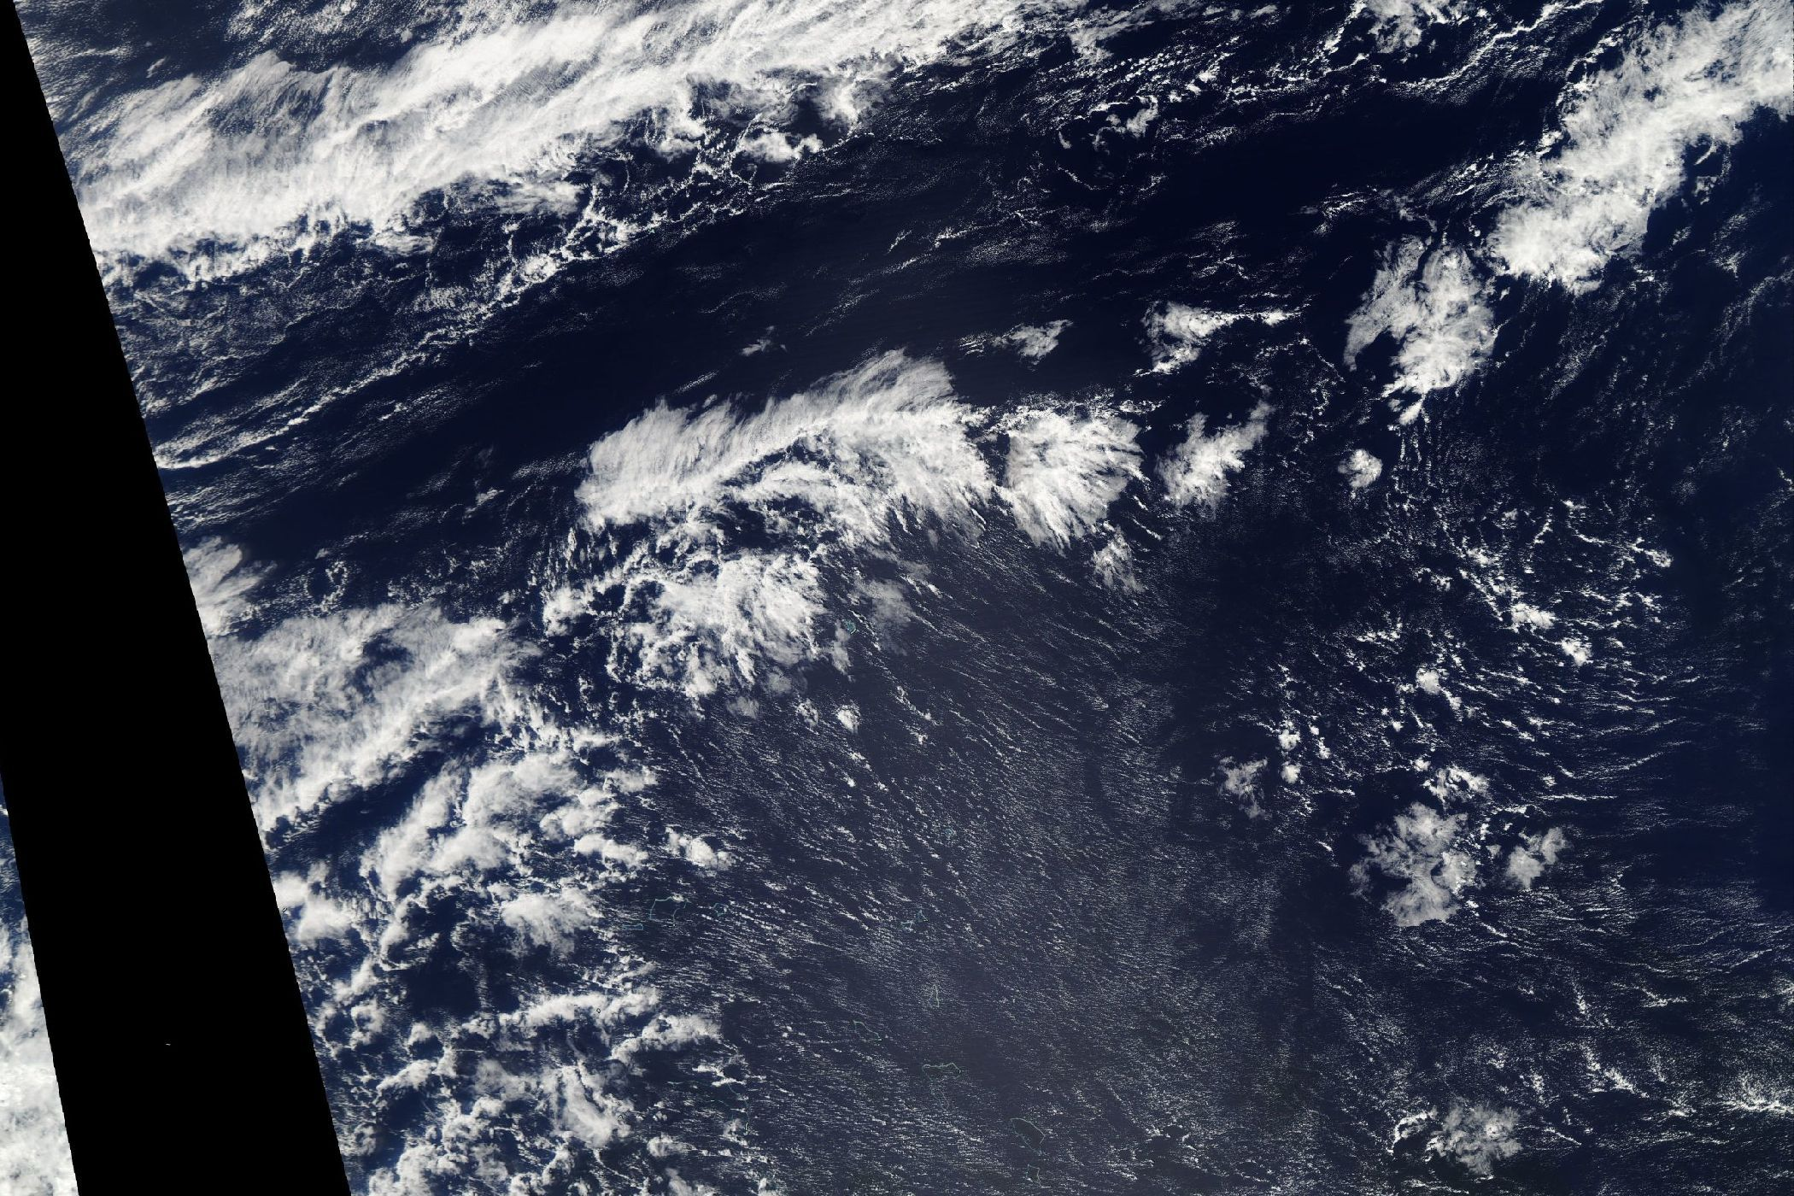
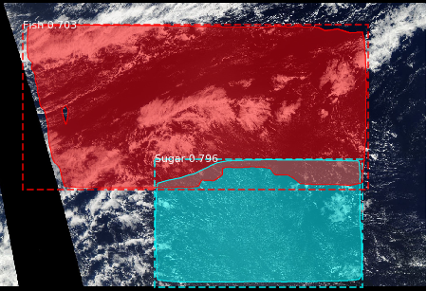
Problem Statement
Object Detection & Instance Segmentation

Slide 6
Problem Statement
Flower
ALL
Or
NONE
Fish
Gravel
Sugar

Slide 7
Solution – Dataset
Train Set
Test Set
5,546 images
train.csv (annotation file)
3,698 images
Model Train Set (80%)
Validation Set (20%)
4,436 images
1,110 images
USED
NOT USED
Dataset retrieved from https://www.kaggle.com/c/understanding_cloud_organization/

Slide 8
Solution – EDA

